Slide 1
at the Edge: Sleep Stage Classification
Alex Anderson-McLeod · Kuba Jerzmanowski · Kasra Korminejad
CSCE 714 · University of South Carolina

Slide 2
What Is Sleep Stage Classification?
Sleep cycles through four to five distinct, measurable physiological stages
Stages per AASM: Wake, N1 (light), N2 (light), N3 (slow-wave/deep), REM
Each stage exhibits characteristic EEG signatures — alpha waves, delta waves, sleep spindles, K-complexes
Accurate staging reveals sleep architecture and its downstream effects on health and cognition

Slide 3
Why Does It Matter?
Sleep stage composition is a direct biomarker for downstream health outcomes
Insufficient N3 (slow-wave sleep) → elevated Alzheimer’s and metabolic disease risk
REM deficiency → impaired memory consolidation and mood dysregulation
Disrupted staging patterns → early indicator of sleep apnea, insomnia, narcolepsy
Longitudinal staging enables clinical diagnosis and personalized treatment

Slide 4
The Gold Standard: Clinical PSG
Polysomnography (PSG) — 20+ channels: EEG, EOG, EMG, cardiorespiratory monitoring
Multi-modal, full-head signal capture → high-fidelity staging across all AASM categories
Automated classification accuracy: ~87–90% (5-class staging)
Manual inter-rater Cohen’s κ ≈ 0.76–0.82 (AASM scoring guidelines)
Requires a sleep clinic, trained technician, overnight stay → not viable for home use

Slide 5
Smart Watches: Ubiquitous but Imprecise
Now standard in consumer wearables — no additional hardware required
Rely on PPG (photoplethysmography) and accelerometry as proxies for neural activity
Cohen’s κ = 0.21–0.53 across six commercial devices [1]
Particularly poor at distinguishing NREM substages (N1 vs. N2 vs. N3)
Adequate for coarse sleep/wake detection; insufficient for clinically meaningful staging

Slide 6
Our Approach: Wearable Single-Channel EEG
Custom lightweight headset — single EEG channel (two electrodes), designed for home use
Captures direct neural signals — fundamentally more informative than wrist PPG
Less intrusive than clinical PSG — practical for nightly, longitudinal monitoring
Projected accuracy: ~80–86%, consistent with comparable single-channel EEG studies [2–4]
Edge inference on Raspberry Pi — self-contained, no network or cloud dependency

Slide 7
Why It Belongs on the Edge
Privacy — EEG contains sensitive biometric data; local processing avoids cloud transmission
Connectivity independence — functions without a network connection
Real-time latency — no round-trip delay to a remote server
Accessibility — compact, self-contained form factor suitable for home deployment

Slide 8
Available Sleep EEG Datasets
SleepEDF — most widely used benchmark; annotated by AASM sleep stage
Fpz-Cz probe locations (comfortable); two versions: SleepEDF-20 (20 subjects) and SleepEDF-78 (78 subjects)
SHHS (Sleep Heart Health Study) — large-scale, but uses uncomfortable probe placement
MASS (Montreal Archive of Sleep Studies) — requires institutional access review
Selected: SleepEDF — openly accessible, widely benchmarked, compatible probe locations

Slide 9
Prior Research
Section 2

Slide 10
Lightweight EEG Sleep Staging in Children at the Edge (Zhu et al., 2022)
Targets pediatric subjects — EEG staging patterns differ meaningfully from adults
Emphasizes privacy benefits of edge-side EEG processing
Five-class staging: Wake, N1, N2, N3, REM
Datasets: SleepEDF (Fpz-Cz probes) and a custom pediatric set
All experiments executed on a high-performance desktop — not deployed to edge hardware

Slide 11
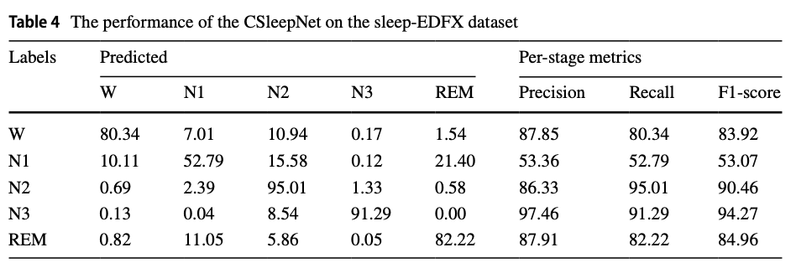
Lightweight EEG Sleep Staging in Children at the Edge (Cont.)
Signal processing in the time domain (not frequency domain)
Input segmented into 30-second epochs; normalized to zero mean and unit variance
Accuracy: 83.06% (custom pediatric dataset), 86.41% (SleepEDF)
Image credit: Zhu et al., World Wide Web, Dec. 2021.

Slide 12
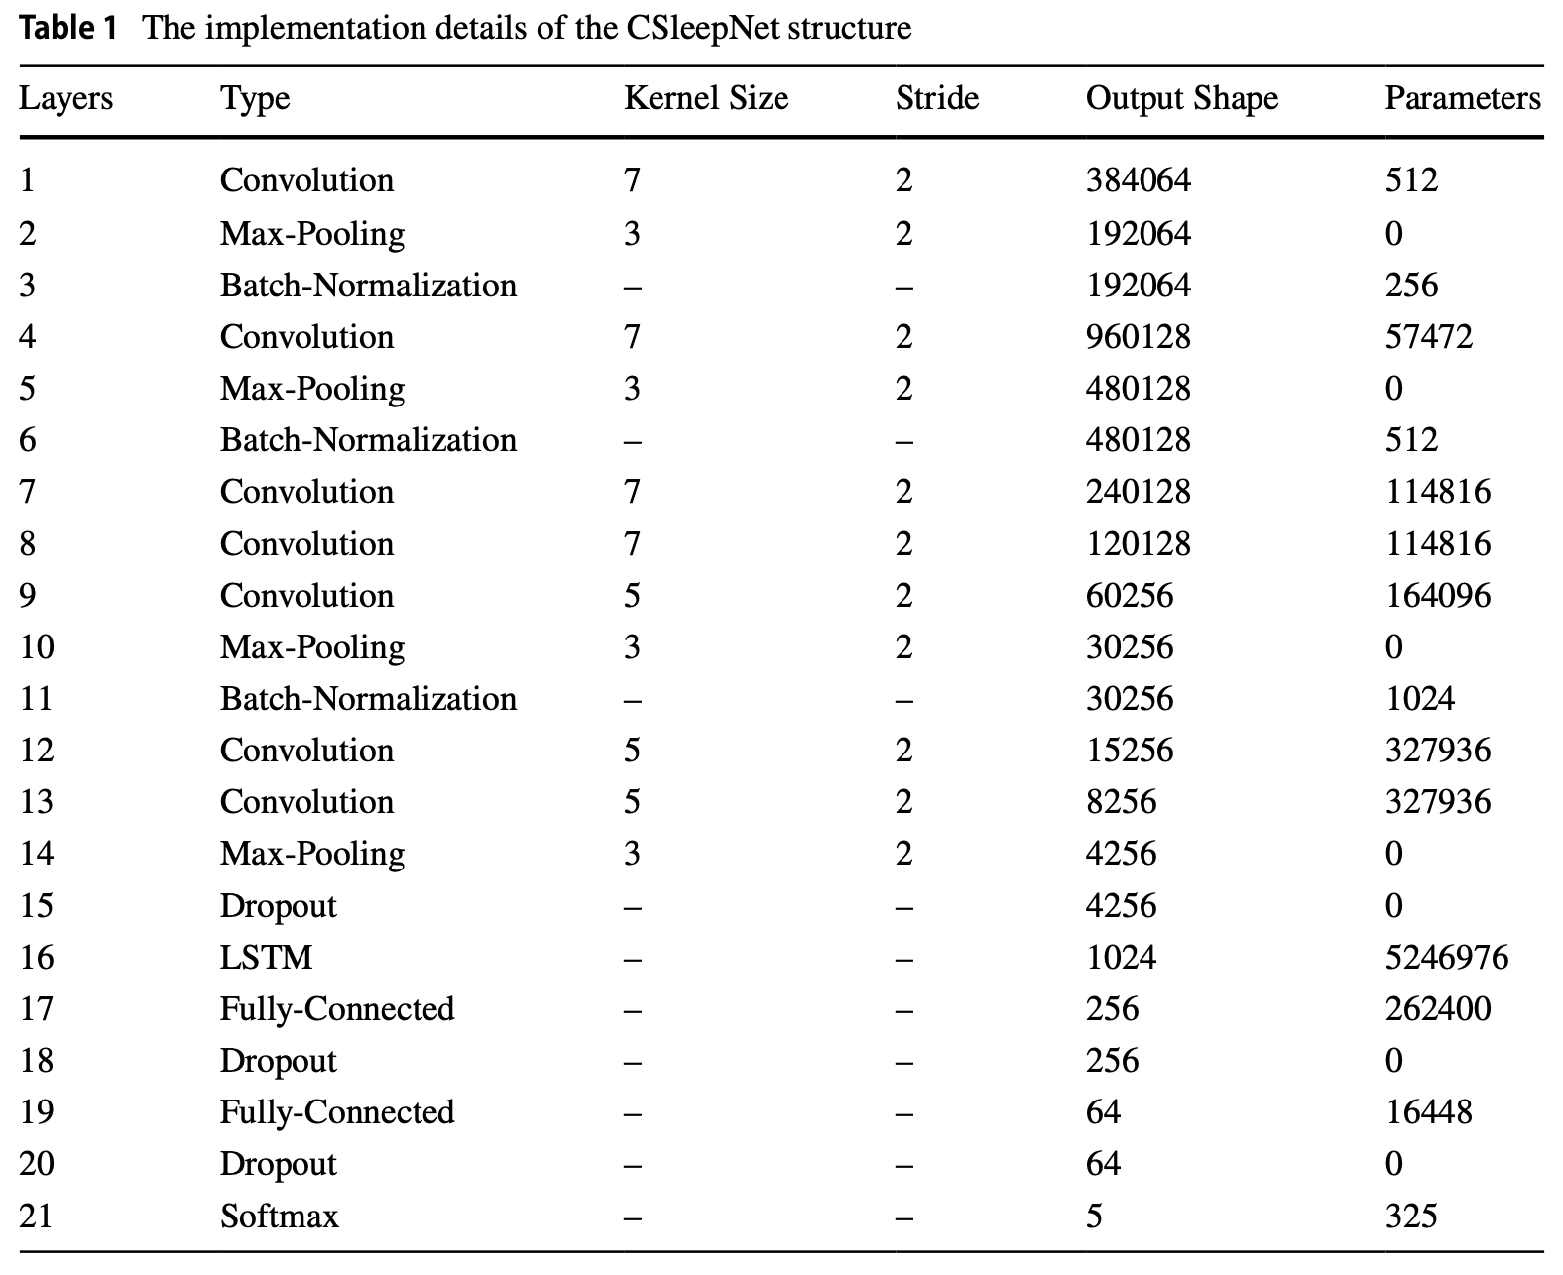
Lightweight EEG Sleep Staging in Children at the Edge (Cont.)
All activation functions: ReLU
Image credit: Zhu et al., World Wide Web, Dec. 2021.

Slide 13
CNN Sleep Disorder Classification on Raspberry Pi (Atianashie Miracle et al., 2021)
Binary classification: healthy vs. unhealthy (sleep apnea, insomnia)
Deployed and tested on a Raspberry Pi — true edge inference
Single EEG channel; signals processed in the time domain
30-second epochs with noise filtering applied before classification
Accuracy: 92% (sleep apnea), 89% (insomnia)

Slide 14
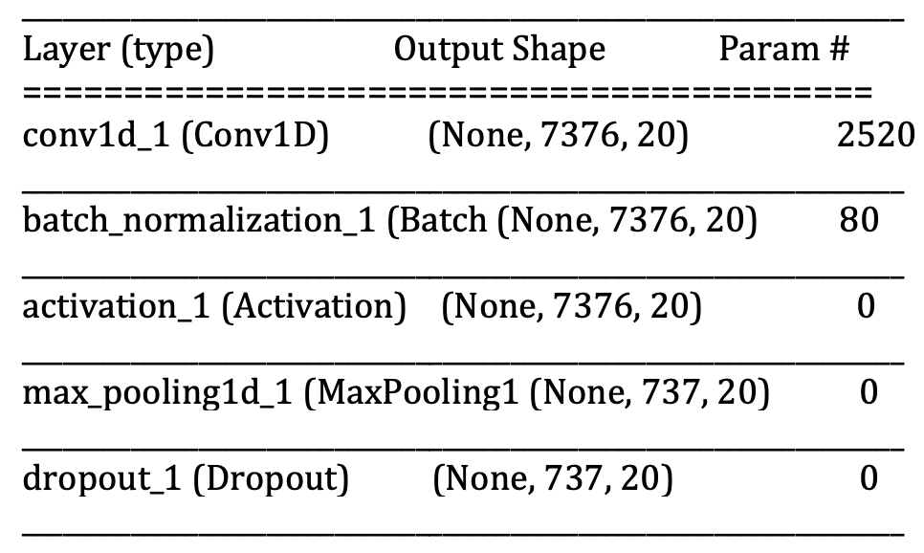
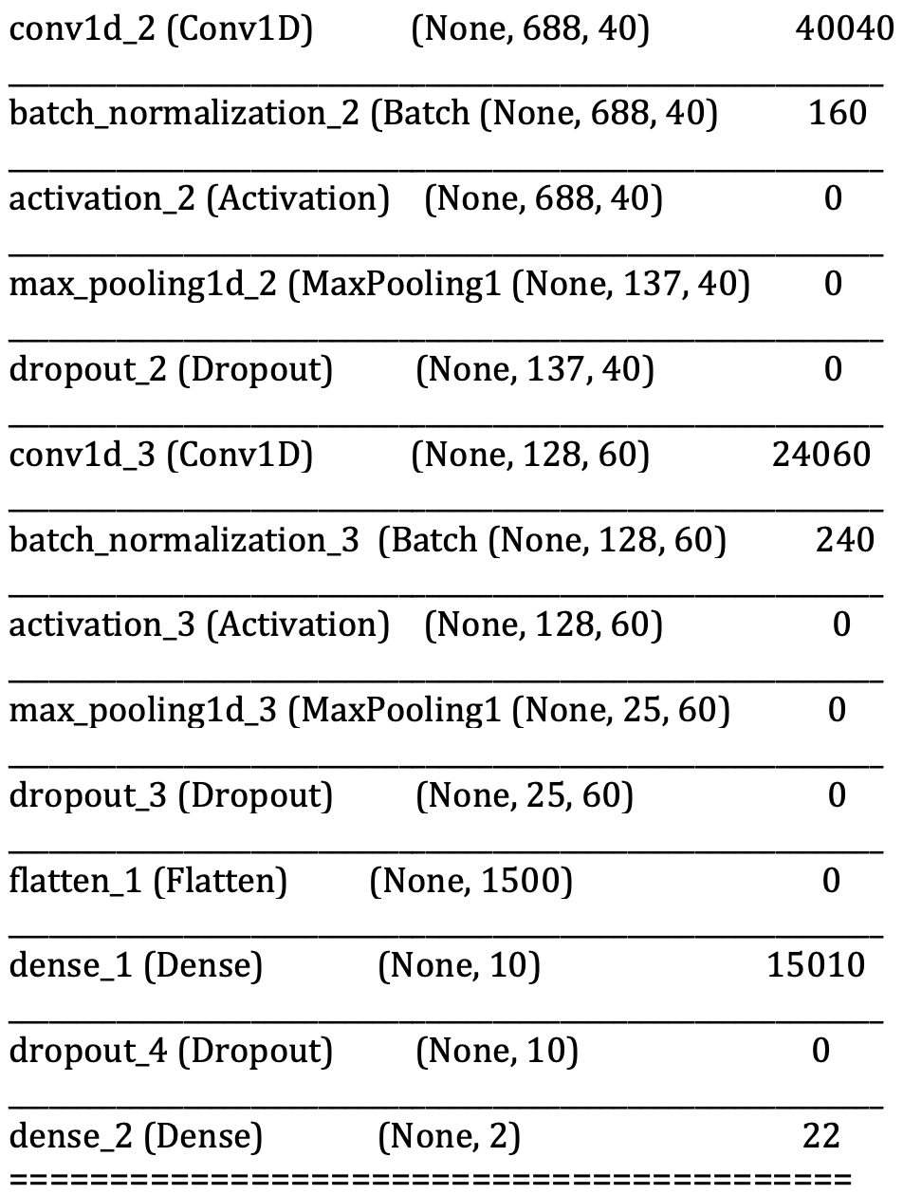
CNN Sleep Disorder Classification on Raspberry Pi (Cont.)
All activation functions: ReLU
Image credit: Atianashie Miracle et al., J. Eng. Appl. Sci. Humanities, 2021.

Slide 15
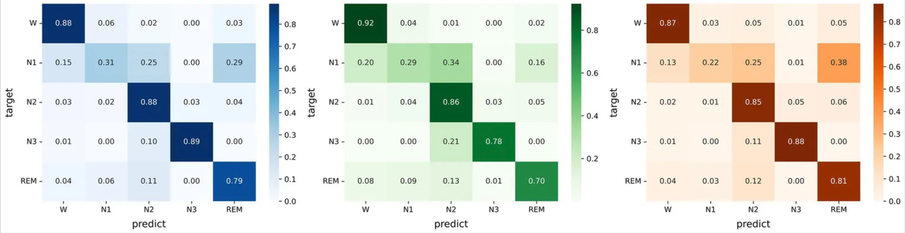
MicroSleepNet: Mobile Real-Time Sleep Staging (Liu et al., 2023)
Deployed on Snapdragon-based Android; inference latency: 2.8 ms
Evaluated on SleepEDF (Fpz-Cz) and SHHS (C4-A1)
SleepEDF: no preprocessing; SHHS: class imbalance correction applied
Standard 30-second epoch segmentation
Accuracy: 83.3% (SHHS), 79.5% (SleepEDF-78), 82.8% (SleepEDF-20)
Image credit: Liu et al., Frontiers in Neuroscience, Jul. 2023.

Slide 16
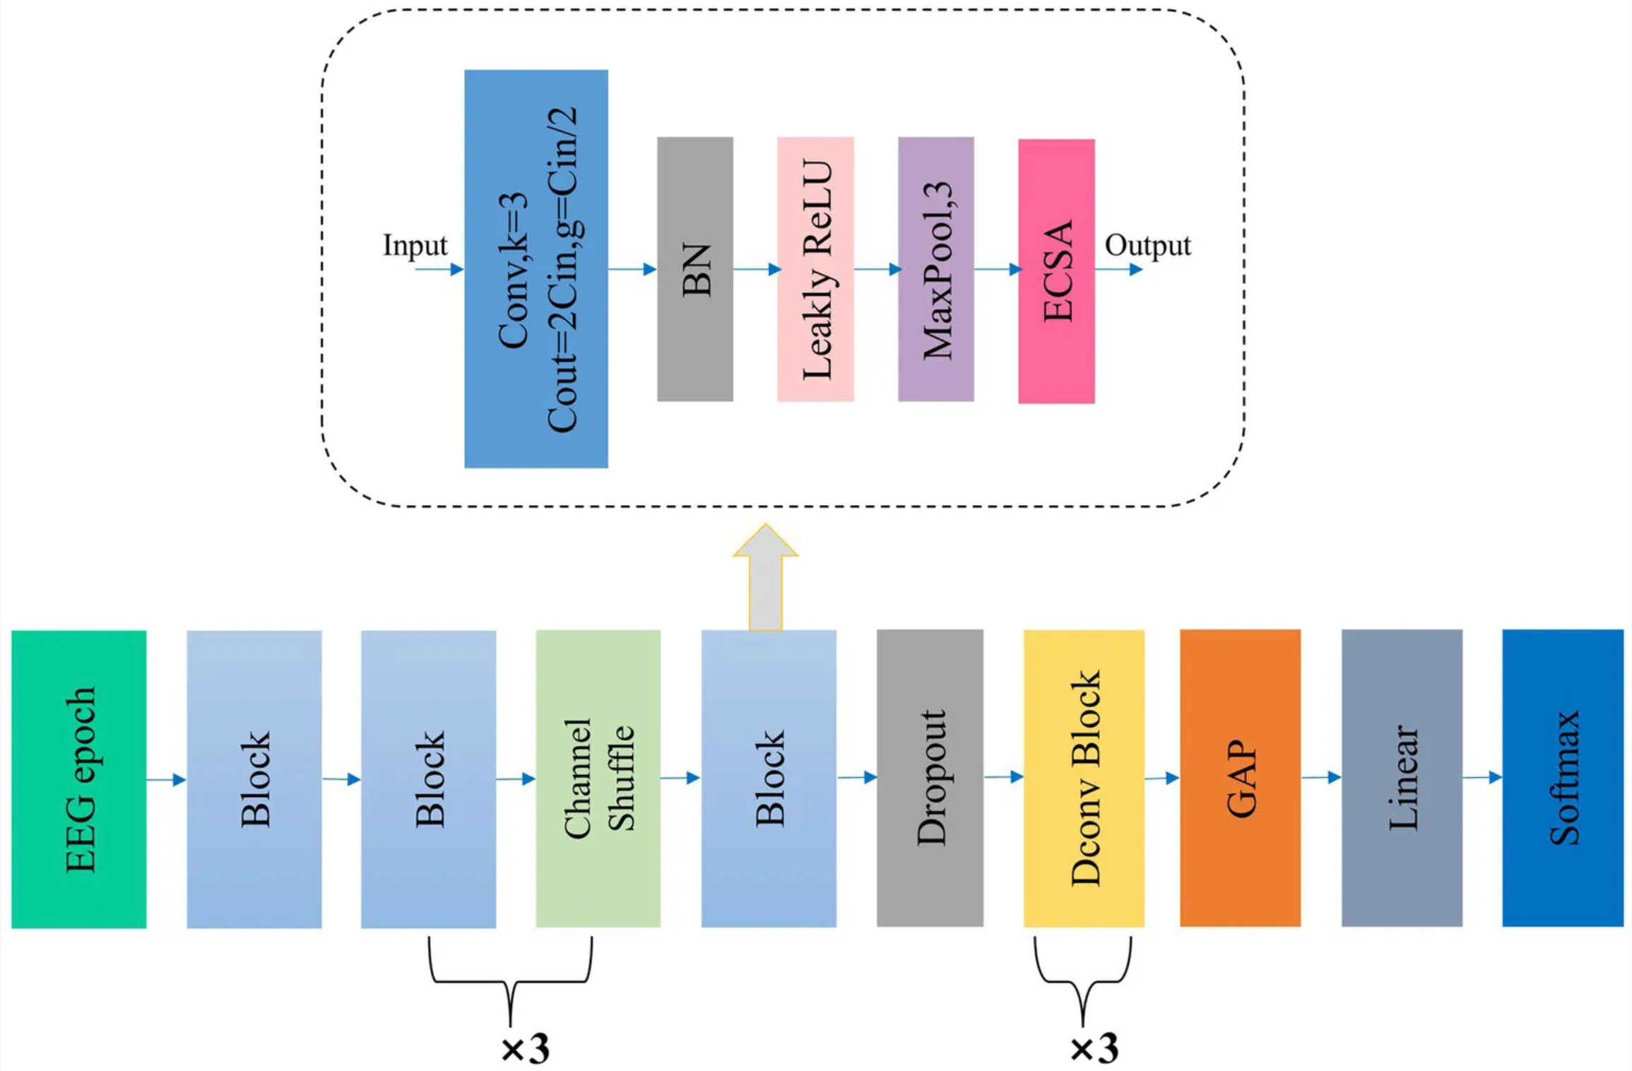
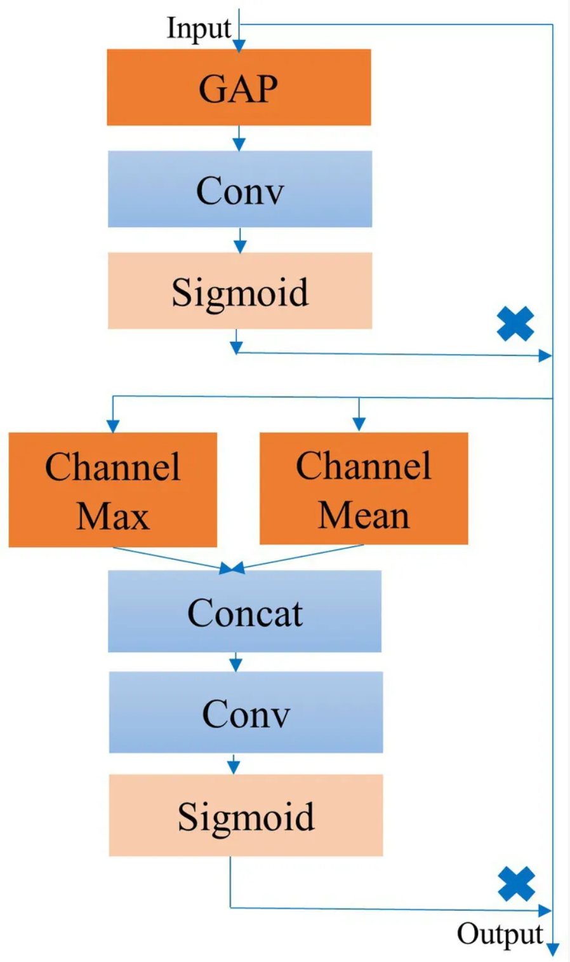
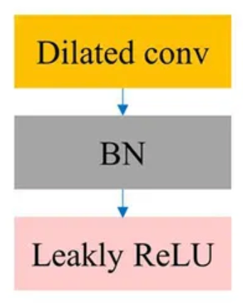
MicroSleepNet: Mobile Real-Time Sleep Staging (Cont.)
Channel shuffle applied between every two convolutional operations
All activation functions: LeakyReLU
Image credit: Liu et al., Frontiers in Neuroscience, Jul. 2023.

Slide 17
References
[1] A.-M. Schyvens et al., “A performance validation of six commercial wrist-worn wearable sleep-tracking devices for sleep stage scoring compared to polysomnography,” Sleep Advances, vol. 6, no. 2, Mar. 2025. doi: 10.1093/sleepadvances/zpaf021.
[2] L. Zhu et al., “A lightweight automatic sleep staging method for children using single-channel EEG based on edge artificial intelligence,” World Wide Web, Dec. 2021. doi: 10.1007/s11280-021-00983-3.
[3] A. Atianashie Miracle et al., “A portable GUI based sleep disorder system classification based on convolution neural networks (CNN) in Raspberry Pi,” J. Eng. Appl. Sci. Humanities, vol. 6, pp. 13–23, 2021.
[4] G. Liu et al., “MicroSleepNet: efficient deep learning model for mobile terminal real-time sleep staging,” Frontiers in Neuroscience, vol. 17, Jul. 2023. doi: 10.3389/fnins.2023.1218072.

